Slide 1
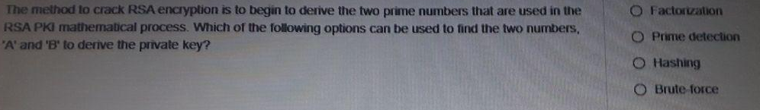
Ans: Factorization

Slide 2
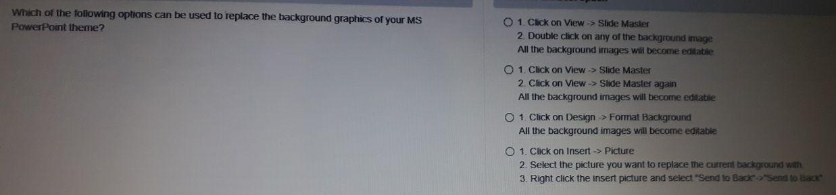
Ans: Option 3
Click on Design -> Format Background
All the background images will become editable

Slide 3
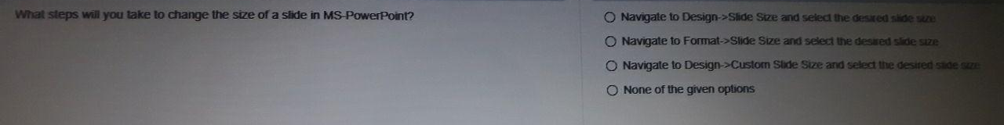
Ans : Option 3

Slide 4
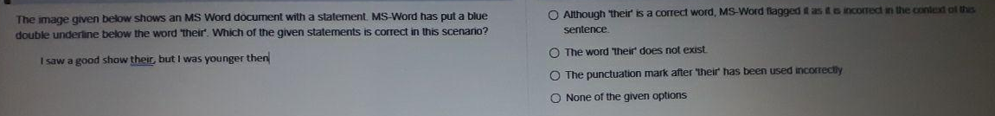
Ans : Option 1
Although “their” is a correct word, MS-word flagged it as it is incorrect in the context of this sentence

Slide 5
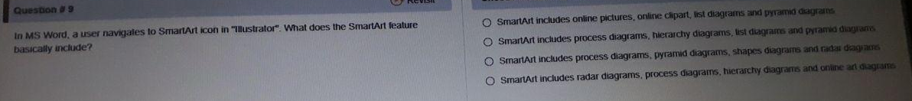
Ans : Option 2
Smart Art includes process diagrams, hierarchy diagrams, list diagrams and pyramid diagrams

Slide 6
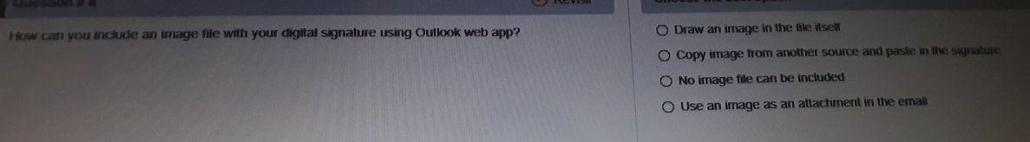
Ans: Option 2
Copy image from another source and paste in the signature

